Slide 1
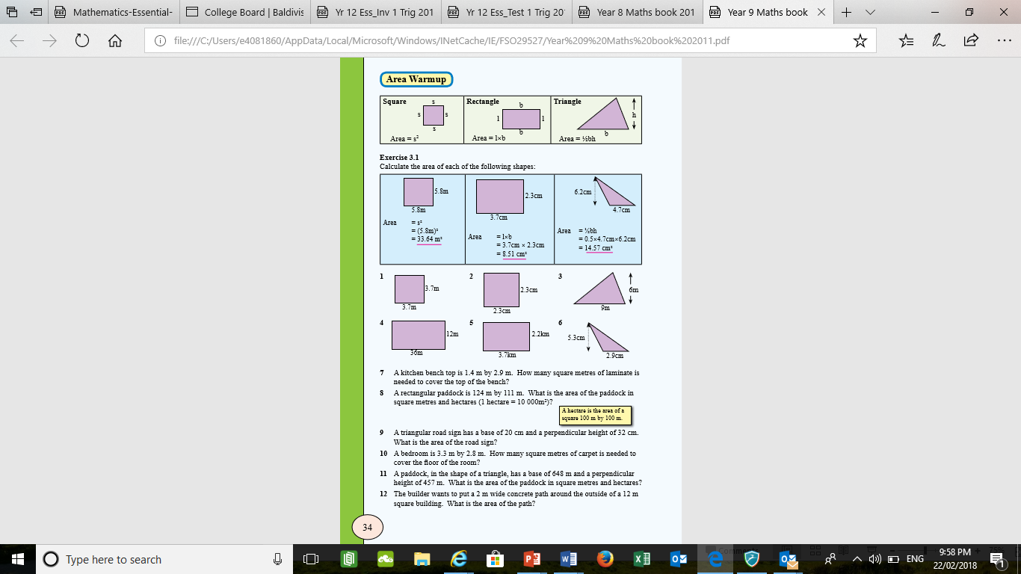
Topic: Measurement
EQ: How do we calculate the area of circles and sectors?
Get your VIVO’s
Topic and EQ in Interactive Notebook
NO PHONES OR EAR BUDS
CONNECT notice
Many of you need to glue in stuff
Have a go:
Finish off:

Slide 2
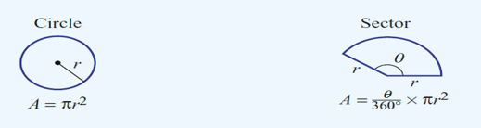
24
7
30
Date
Measurement
EQ: How do we calculate the area of circles and sectors?
Refer to your area formula handout

Slide 3
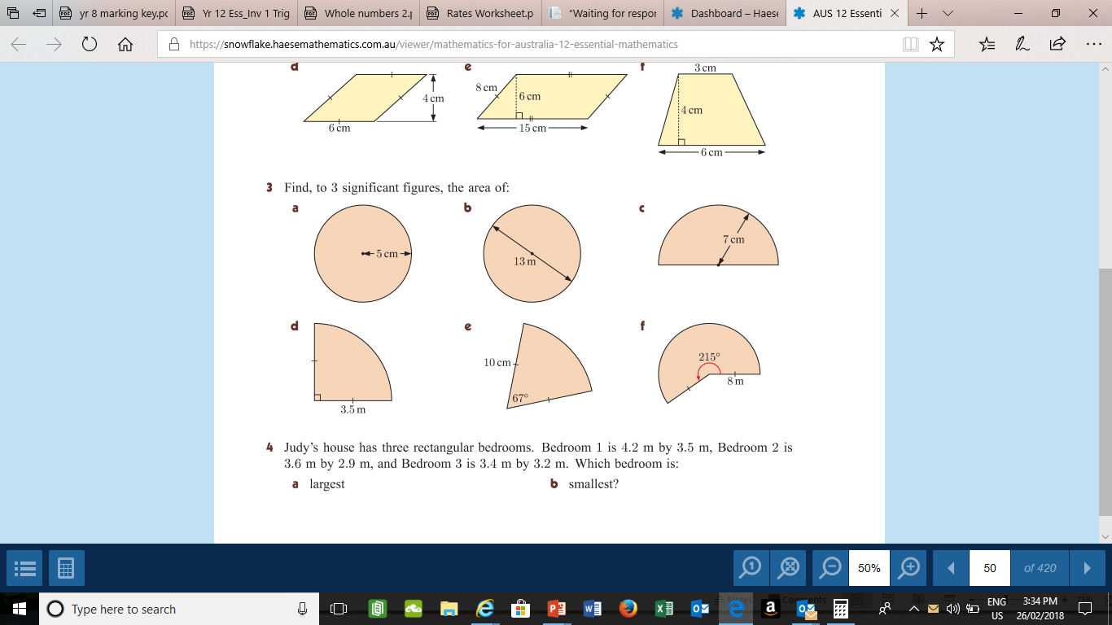
Practice.

Slide 4
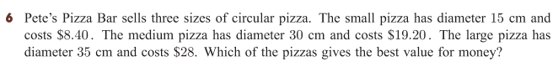
Bonus Question:

Slide 5
Now Complete in pairs/groups
“Area questions- You should aim to understand these!!!!!!!”worksheet
THIS IS IMPORTANT

Slide 6
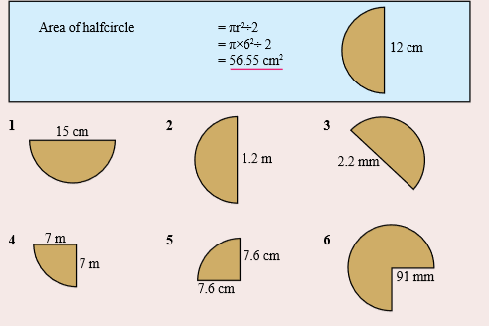
Extra work:

